Slide 1
BTP-2
Plagiarism Detector Tool

Slide 2

First Apologies

Slide 3
What is Plagiarism?

Slide 4
And How to Detect it?

Slide 5
Plagiarism
Plagiarism has been identified as theft of intellectual property by Lancaster and Culwin. It can further be defined as turning of someone else’s work as your own without reference to the original source. Commonly observed plagiarism methods are listed below
Copy - Paste Plagiarism (Directly copying word to word)
Paraphrasing (Restating same content in different words)
Artistic Plagiarism (Presenting same Content but with different media)
Idea Plagiarism (Using similar kind of ideas)
Code Plagiarism (Using directly available code snippets with permission)
The Art of Copying

Slide 6
Detection
Read TEXT from document.
NLP Preprocessing
Tokenize
Stemming
Lemmatization
Spell Checker
Remove Stop Words
Removing Punctuation
Google API Search
Collect Relevant Links
Retrieve Text From the Selected Links
Check Similarity and Report

Slide 7
Pre-Processing
It is necessary because the text contains a lot of information
Some of this information is irrelevant and needs to be removed before we proceed
So to improve the quality of our analysis it is necessary

Slide 8
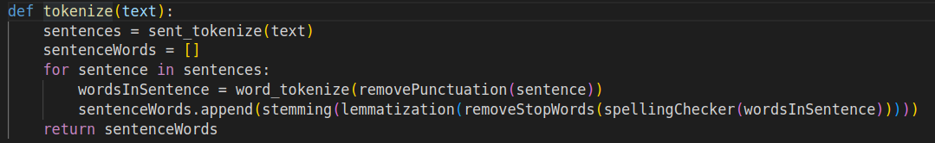
Tokenization
To get to the similarity module, we first need a mathematical representation of the input document.
To do so there are several techniques, most of them involve finding vectorial representation of words in a document.
So, to get words from a sentence this tokenization step is important.

Slide 9
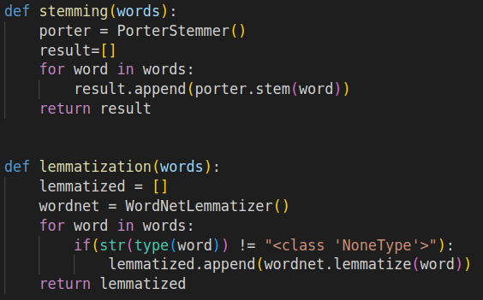
Stemming and Lemmatization
But we cannot just proceed to analysis after breaking the sentences into words.
Words like dance, dancing; sing or singing carry the same weight it does not matter in what form they come
So, to handle such case we deploy stemming and lemmatization to get the root word.

Slide 10
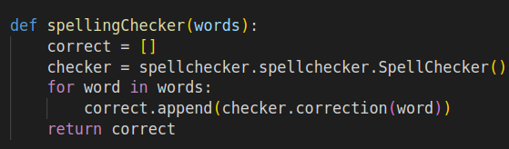
Spell Checker
But before getting the root words it is possible that there has been a typing error or perhaps an error has been made intentionally to surpass the plagiarism detectors.
So, we use spell checker module so as to check the spellings.

Slide 11
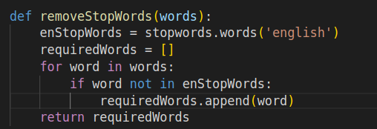
Stop Word Removal
There are words in english which are the most common words and these are the words which do not carry any weight in the information supplied by that sentence.
For instance, the words like “The”, “an” or “a” do not add semantic value to a sentence

Slide 12

Remove Punctuation
Punctuation marks are important so as to get the right meaning from a sentence
But as far as our analysis is concerned we do not really need punctuation marks. A sentence without punctuation marks if matches with another sentence. It is still plagiarism for which we can reason intuitively.

Slide 13
Web Search

Slide 14
Google API
Once we have the preprocessing done, we now have
The sentences in the input document
The Relevant words in those documents
Now we search each sentence using the google API and we pick the first “N” Hits which the search API returns
We do this for all sentences and we collect all such returned URLs
We then remove the duplicate URLs

Slide 15
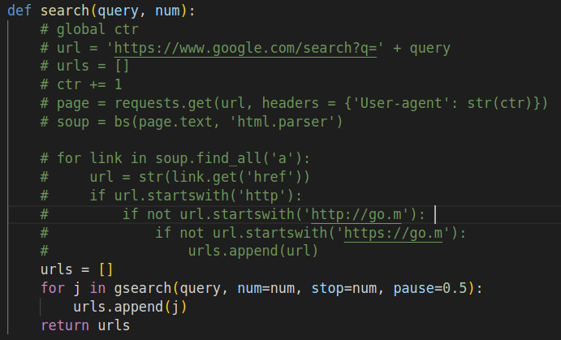
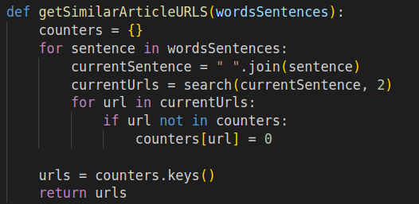
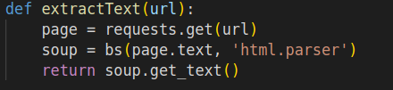
Text Extraction From URLs

Slide 16
Similarity Module
To Find similarity between two documents we need to represent them. So we use embeddings to represent them.

Slide 17
Approaches
Bag Of Words Representation
Finding Embeddings using SVD and CBOW
Using Glove Embeddings
Using BERT Model
Using Auto Encoder to Generate Embeddings

Slide 18
BOW
It is the simplest Model of embeddings
Here we encode(to integer value) every different Word Occuring in the Input Text and the Text Retrieved from Online Sources
Then we use these encodings to generate vector representation of sentences.
Then we take average of the representations of all sentences in a document to get the document vector
Then we take distance between the input document vector and the Online Source Document Vector

Slide 19
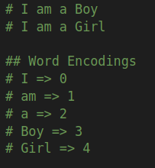
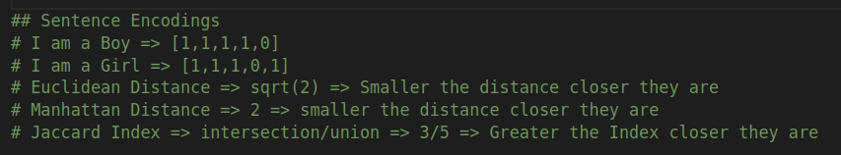
BOW Explanation

Slide 20
SVD and CBOW
SVD and CBOW are both Techniques to reduce dimensionality
SVD is Singular Value Decomposition.
Why no try PCA(?)
SVD is same as PCA (Eigen Value Based)

Slide 21
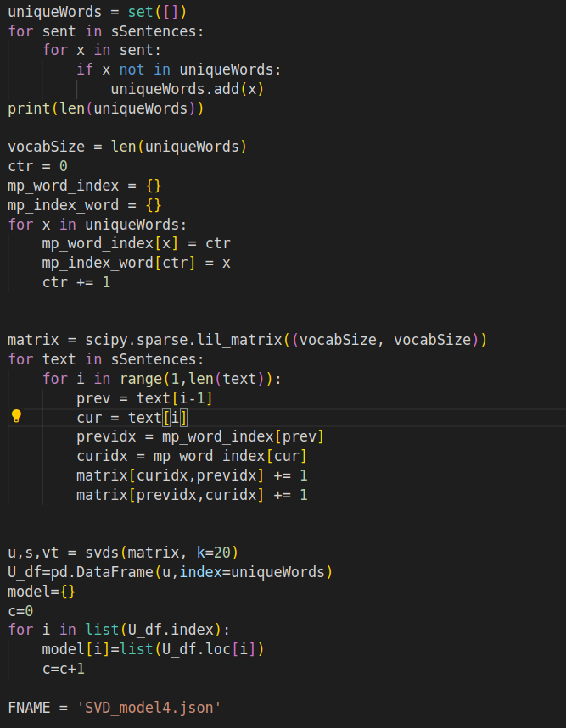
SVD Demonstration

Slide 22
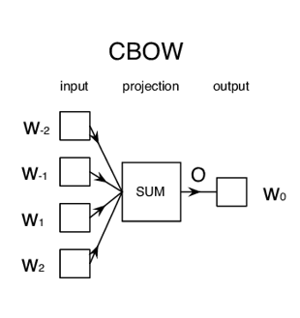
CBOW Demonstration
Taking Context of a Word in Account
(Non Neural Network Approach)

Slide 23
Glove Embeddings
GloVe Embeddings are a type of word embedding that encode the co-occurrence probability ratio between two words as vector differences.
GloVe Embedding are Different from Word2Vec that is CBOW approach because Word2Vec is based on “taking context into account” whereas the crux of GloVe Embeddings is co-occurence

Slide 24
BERT Embeddings
Bidirectional Encoder Representations from Transformers is a transformer-based machine learning technique for natural language processing pre-training developed by Google.
A DNN Comprising of 24 Neural Network Layers
State of the Art Model designed by Google

Slide 25
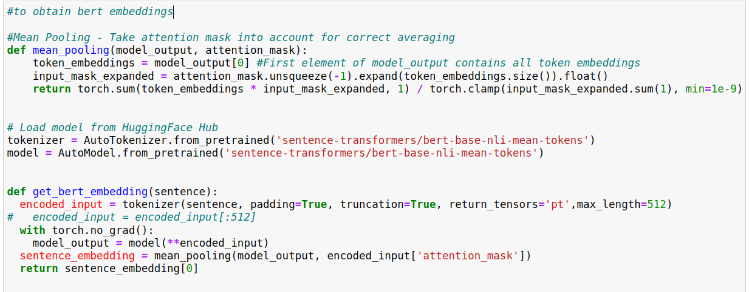
BERT Embeddings

Slide 26
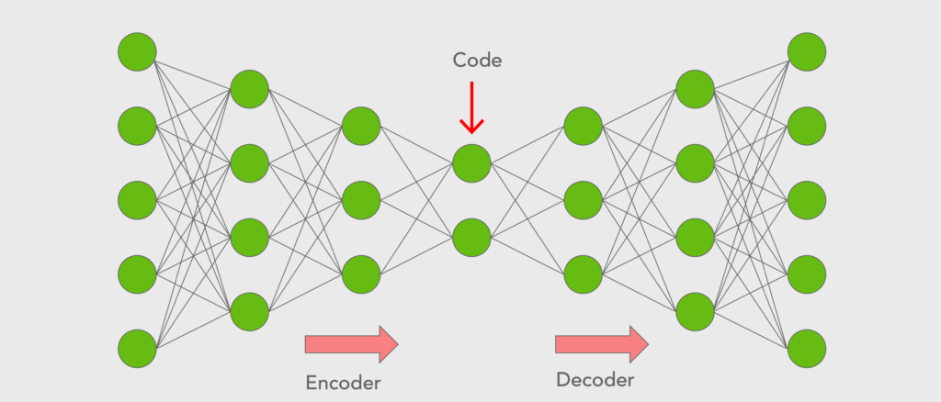
AutoEncoder
Training Neural Network Layers on some input x which results in an output x (Same as input).
So let's say we train our model as
10000 => 1000 => 400 => 100 => 400 => 1000 => 1000
Here the First Part that is 10000 => 1000 => 400 => 100 is the encodes and encodes the input of 10000 dimension to a vector of 100 dimension
Remaining Part is called Decoder
We Use encoder to encode our input large dimension sentences to get a shorted encoded handleable version

Slide 27
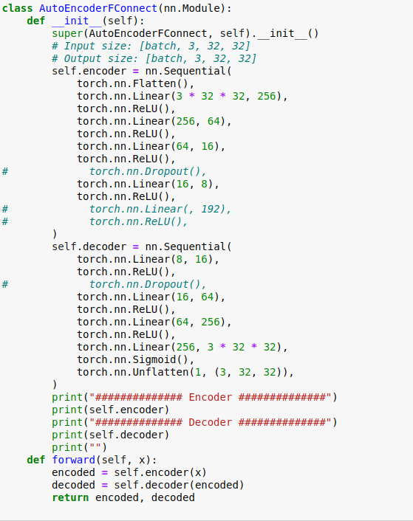

Slide 28


The Goal of all the previous Neural Network and Other Classical Model was to get an Embedding/ Representation of a Document

Slide 29
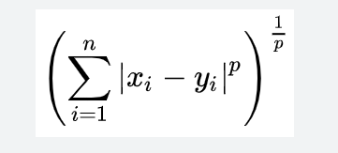
Similarity Module
Once we have the document vectors, the next thing we need is to check the similarity between the two. There are 2 approaches
First is to use a Similarity Index
Jaccard Index
Cosine Similarity
Second is to use a Distance Metric
Euclidean Distance
Manhattan Distance
Minkowski Distance (General)
With Similarity, larger the value the more similar they are
With Distance, Larger the Distance the less similar they are.

Slide 30
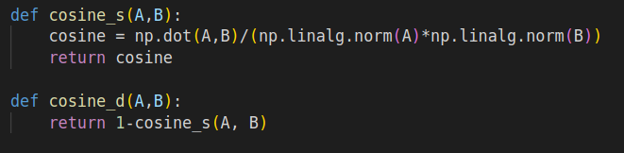
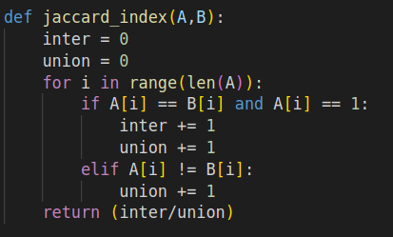
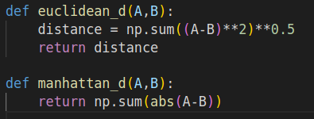


Slide 31
Conclusion
Therefore we have seen the architecture of how out plagiarism detector works. We tried testing a whole variety of methods but we ultimately found the classical methods work the best. With Neural Networks we ran into these issues
Lack of Data, For instance we trained our AutoEncoder and other models using a corpus containing thousands of sentences. But when we consider matching things with Online Sources our search space shoots up and things start to behave abnormally
One other issue might be the fact that good Neural Models do not get trained overnight. It takes time to train good ones, using more number of epochs or perhaps tweaking models here and there. Personalizing them for our Use Case

Slide 32
Demo
For a text which is nothing but a summary of the Movie “Lipstick Under My Burkha”
Similarity Threshold is to be kept low as the text retrieved from the web contains a lot of extra things which contribute towards.
We got the following Links (Top Hits By Our Code)

Slide 33
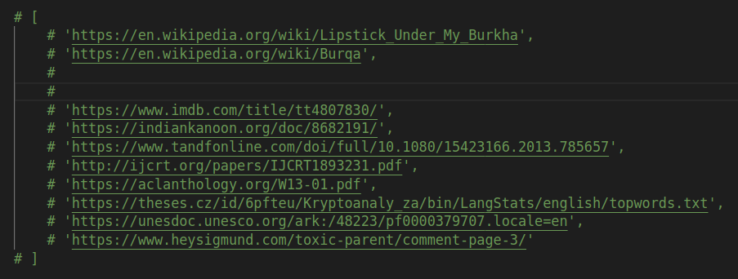

Slide 34
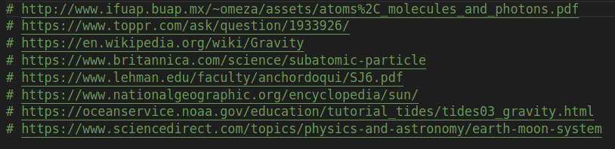
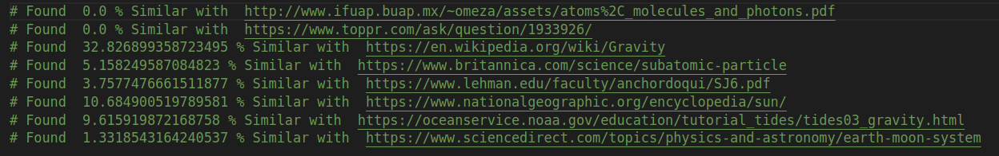
https://docs.google.com/document/d/1zKvza8FhlFgPxTqDBkfJzFoeHOmsNWZ5lLyU_AZdVKY/edit?usp=sharing
Top hits below(WikiPedia Copy):

Slide 35
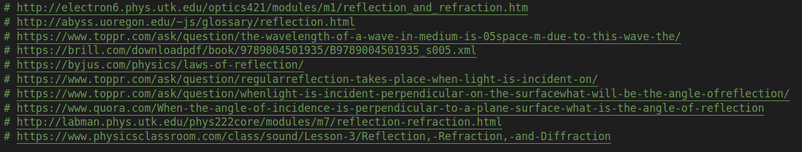
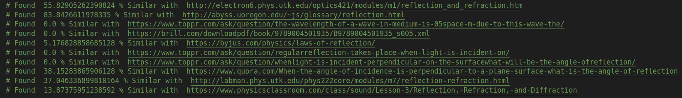
https://docs.google.com/document/d/1JQe76qRsSgPcjMv-Mn7gr8IoE8uCurem-1duE282CEo/edit?usp=sharing
Top Hits =>

Slide 36
Thank You
Kartik Garg (2019101060)
Shreyash Rai (2019101096)
Harshit Sharma (2019101083)

